Slide 1
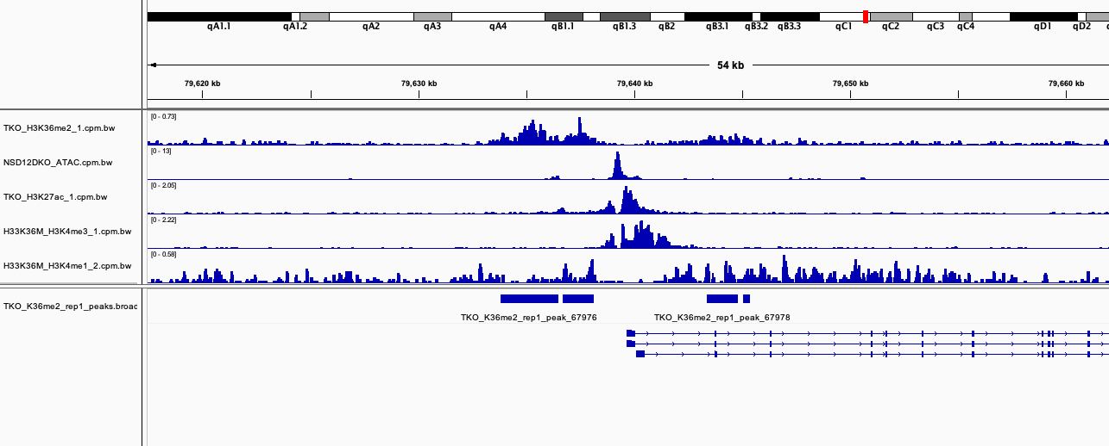
Promoter Peak
Most of these 36me2 peaks are actually broad “double peaks”
They are centred on ATAC peaks = no nucleosome at promoter
The ATAC peak is also ”straddled” by K27ac
The ATAC peak is also ”straddled” by K4me3
And K4me1 looks a bit like 36me2…
Merge (peak 1)
Merge (peak 2)
Perhaps we should merge peak 1 and 2 into a “double peak” 1*?
So in this example, if we centre the picture on the ATAC peak or promoter, and average across all such regions
We should get the aggregate plot of the type I described earlier. Question is, how careful do we need to be about
Merging all the K36me2 peaks?

Slide 2
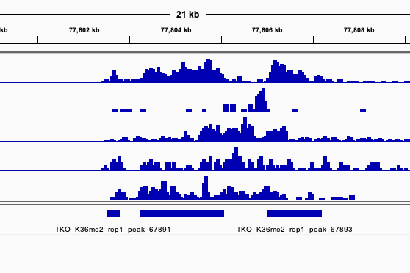
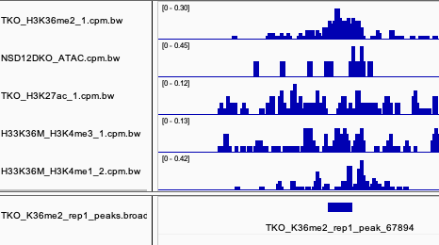
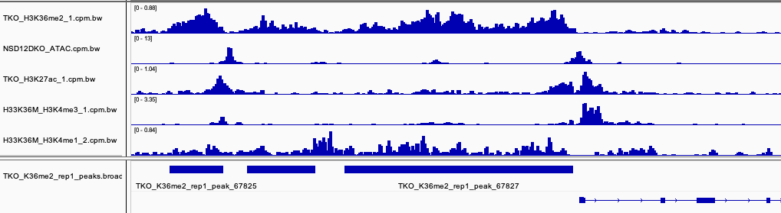
An enhancer peak
A weak enhancer peak
(probably would not be called
using ATAC)
Adjacent promoter and enhancer peaks that would be merged using 36me2, but can be resolved using ATAC
So for now, my suggestion would be to somewhat aggressively merge K36me2 peaks, then for further analysis ask:
How may have ATAC peaks within (I think most will) and centre aggregate analysis on those ATAC peaks (separately
If more than one present). You can take ATAC data from DKO or K36M, don’t think we have it for TKO.

